Slide 1
Senior Nutrition and Optimal Wellness

Slide 2
What is the Purpose of Senior NOW?
A community based partnership to provide seniors with science based nutrition and medication support and education to promote healthy behavior and successful aging.

Slide 3
How is it Possible?
Partnerships
Broward County Elderly and Veterans Services Division
Broward County Transit
Center for Hearing and Communication
Center for Independent Living
Florida Introduces Physical Activity and Nutrition to Youth (FLIPANY)
Florida Atlantic University
Lighthouse of Broward
Senior Volunteer Services
Sun Trolley

Slide 4
How is it Possible?
Funded by United Way
grant for pilot study
Benefits
Not income driven
Targets seniors not eligible for other senior assistance programs
United Way of Broward County is a funded Community Impact Partner.

Slide 5
Program Components
Nutritional Assessment
Prescription Medication Education
Nutrition Education conducted by RD (5 classes)
Cooking Demonstration

Slide 6
Nutritional Assessment
Mini Nutrition Assessment conducted by an Registered Dietitian
used to develop an individual nutrition plan

Slide 7
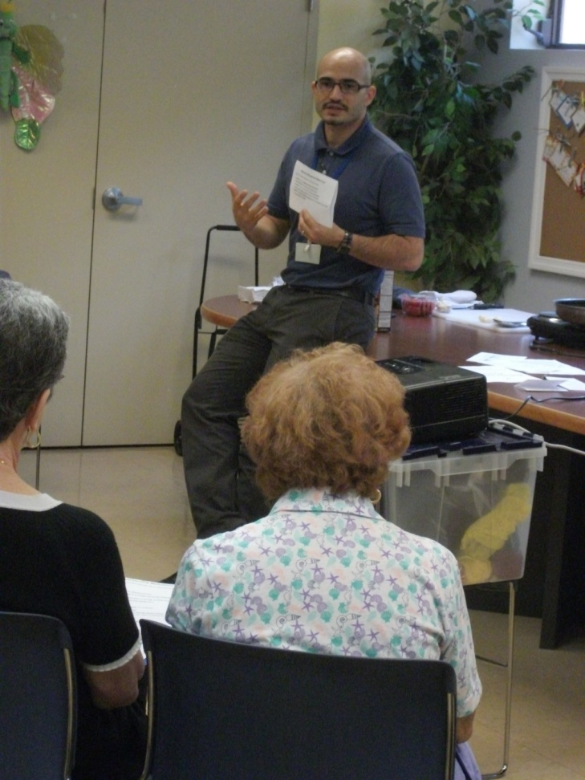
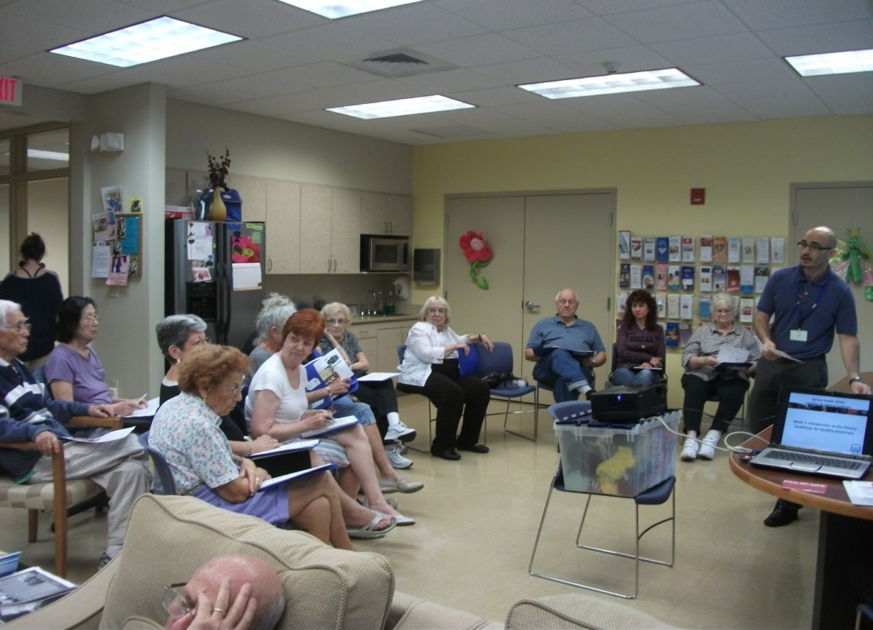
Prescription Medication Education
World Health Organization (WHO )assessment questionnaire to determine elder’s Medication compliance and pinpoint individualized educational needs for effective medication management.

Slide 8
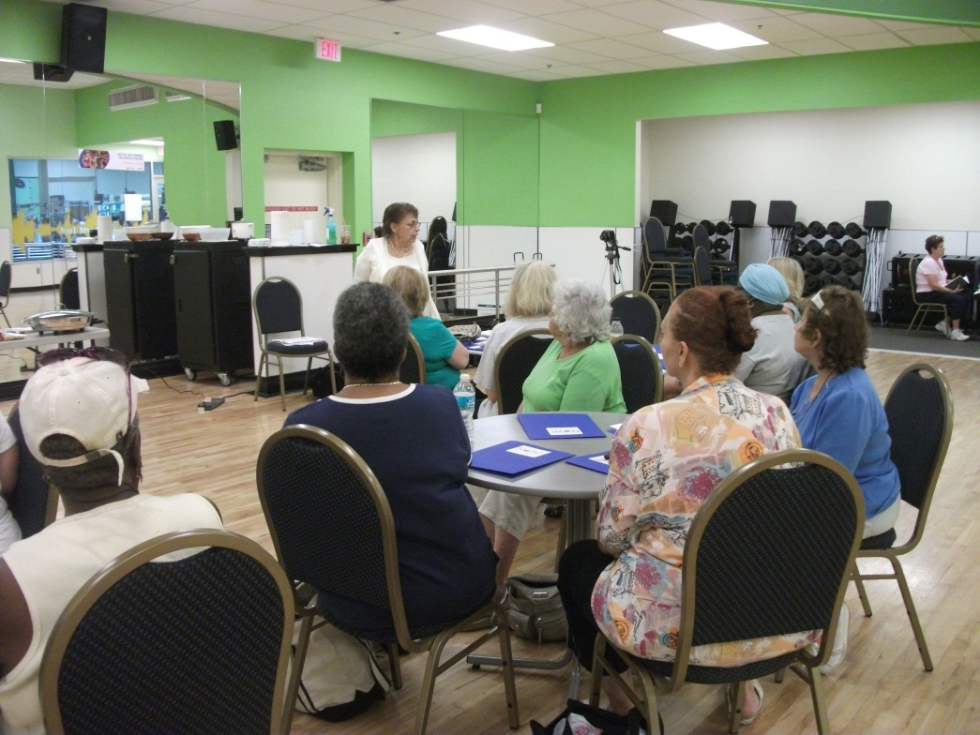
Nutrition Education
Taught by a Registered Dietitian (RD)
5 Classes utilizing the Dietary Guidelines for Healthy Americans
Includes a Grocery Store Tour to illustrate Class Principles

Slide 9
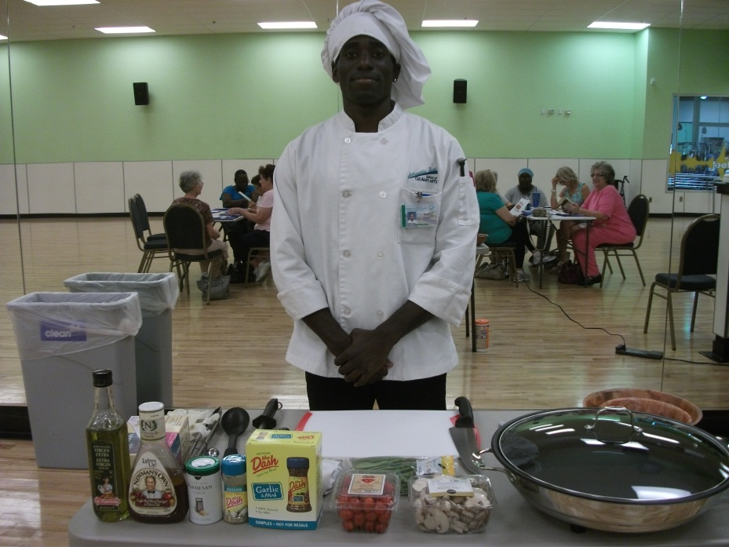
Cooking Demonstration
Taught by a Chef
Demonstration of healthy, quick and simple meals and snacks
Portioned for 1-2 people
Easy preparation and clean up
Seniors are taught preparation shortcuts and use of healthy convenience foods throughout cooking presentation

Slide 10
Improvements
Year 1
Emphasis on fruits and vegetables
Low utilization of recipes provided
More marketing required to recruit Seniors.
Recipes yielded 8-10 servings
90% attendance
Year 2
Emphasis on Dietary Guidelines for Older Americans
Many Seniors reported using recipes in home
More requests for additional classes throughout community
Recipes modified for 1-2 servings
99% attendance

Slide 11
Impact thus Far
“The entire concept of lecture/demonstration/ preparation and eating the final product has been a tremendous experience. I now expect to live ANOTHER 78 years.”
“I learned when to take my medication.”
“This was such an eye opener. This program saved my life. I had no idea how important it was to take my potassium.”
“Thanks to this class my cholesterol went down 50 points.”
“Ann taught me how to read nutrition labels and now I can find the right foods in the grocery store.”

Slide 12
Sustainability
Fee for Service
Sponsors
Food Companies
Fitness Centers
Community Service Groups
Corporate Office
Partnership with Hospitals under the Affordability Care Act
Grants from Insurance Companies

Slide 13
Success Story
Trudy
Was unable to grocery shop
Senior NOW Program taught her how to use the motorized cart in Publix
The program facilitated personal shopping assistance from Publix for her.
She said, “You have opened up my life, I can now shop for myself!”

Slide 14
A picture is worth 1,000 words

Slide 15
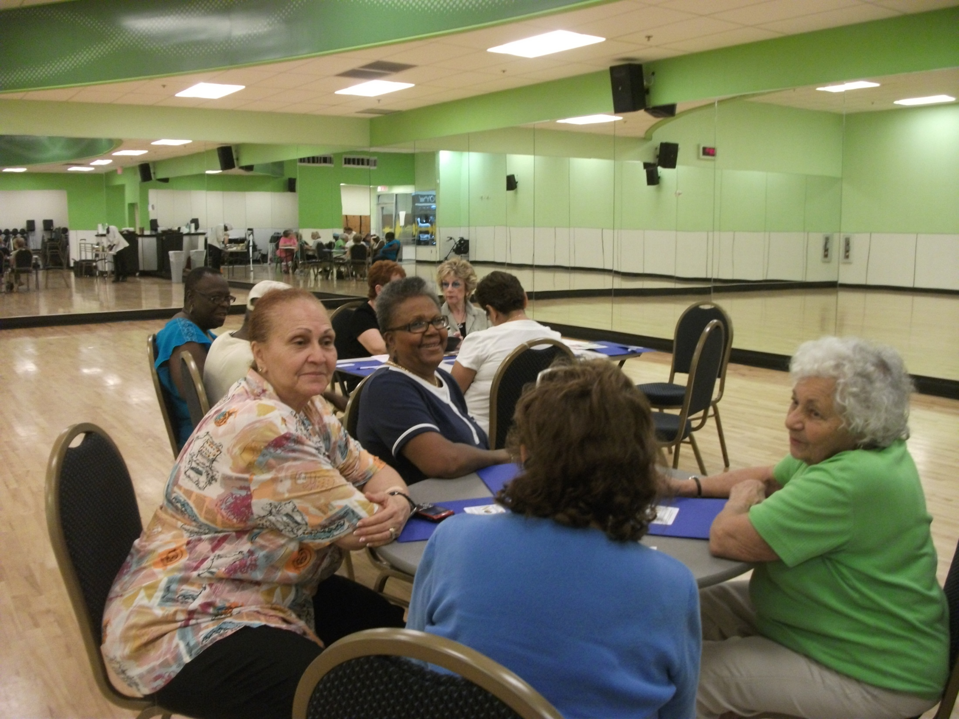
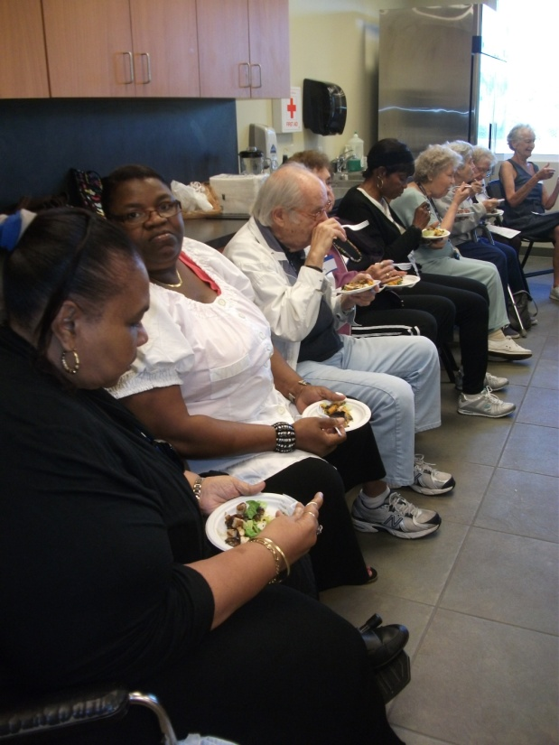
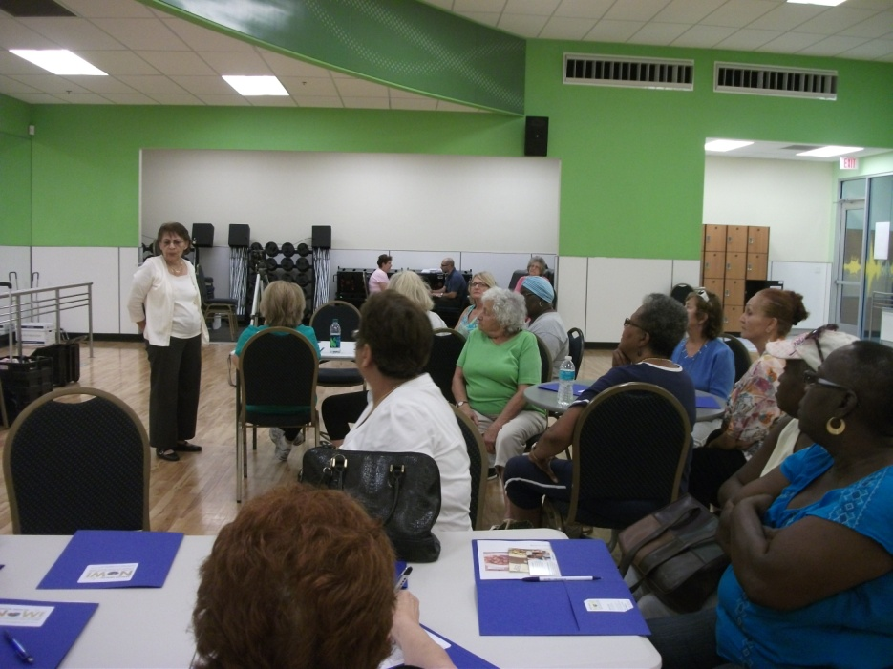
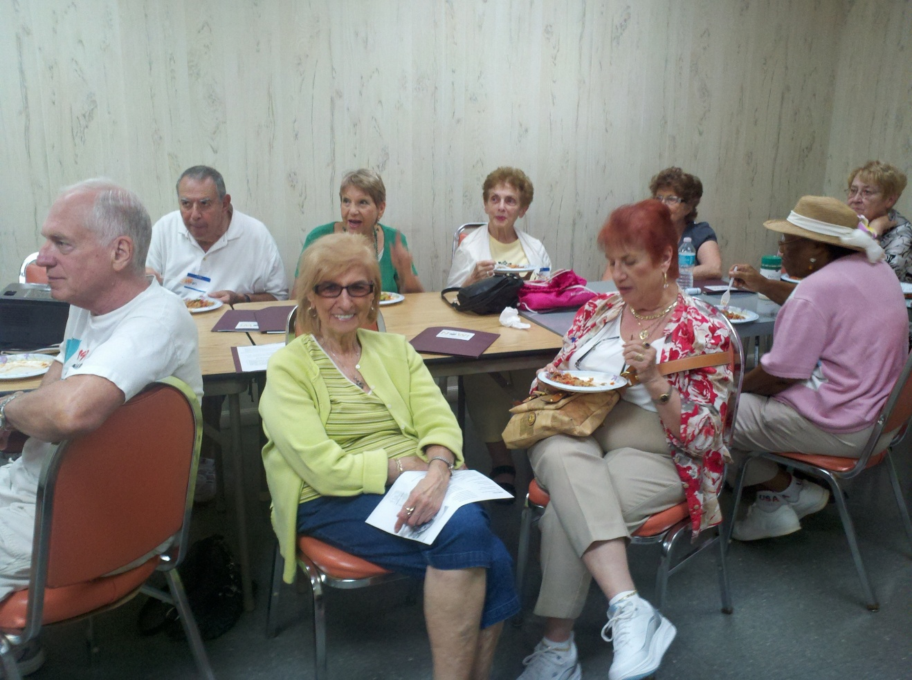
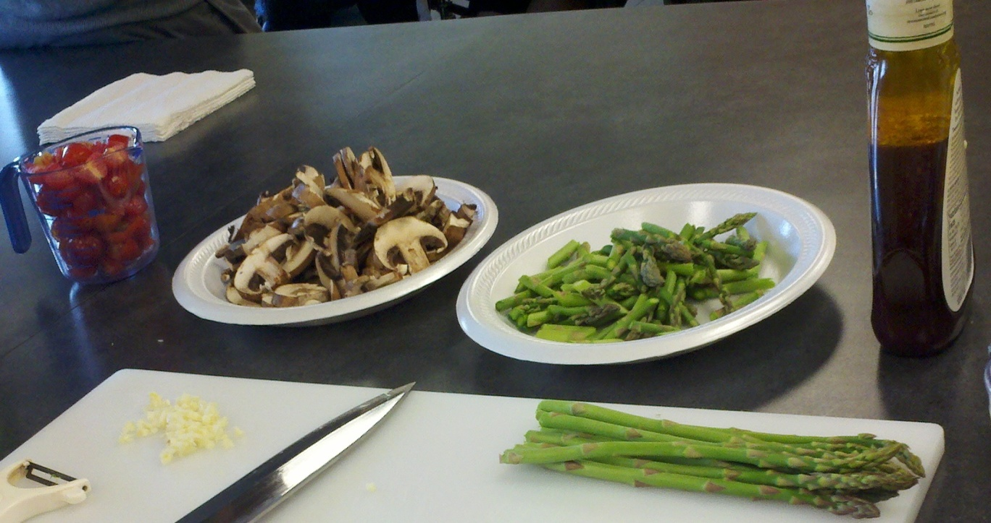
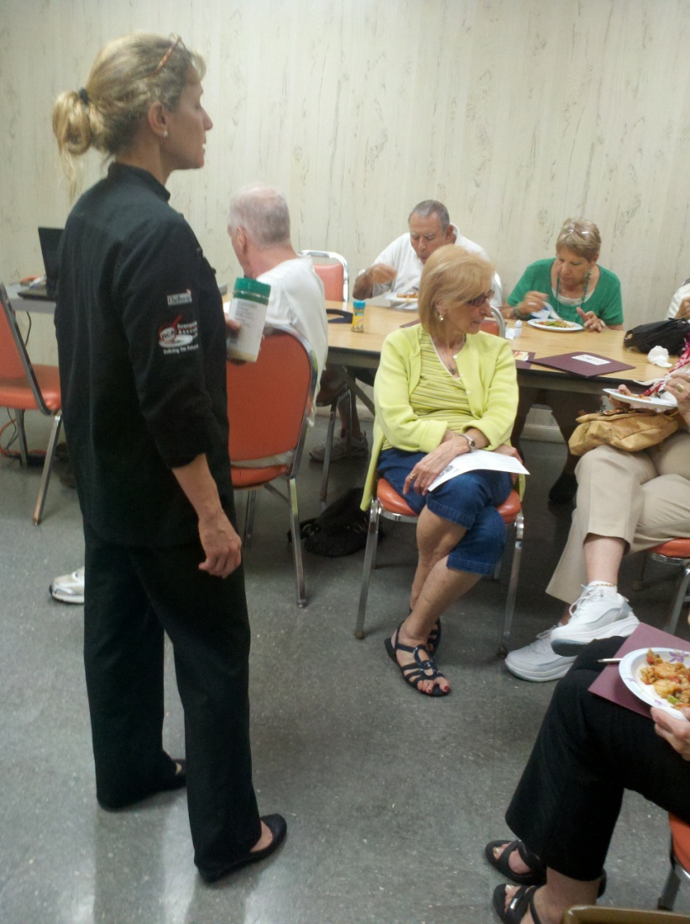
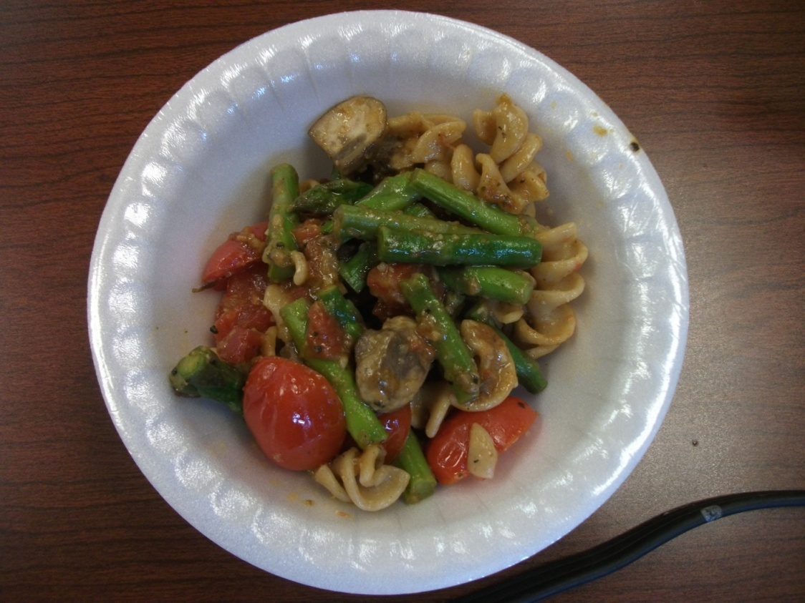
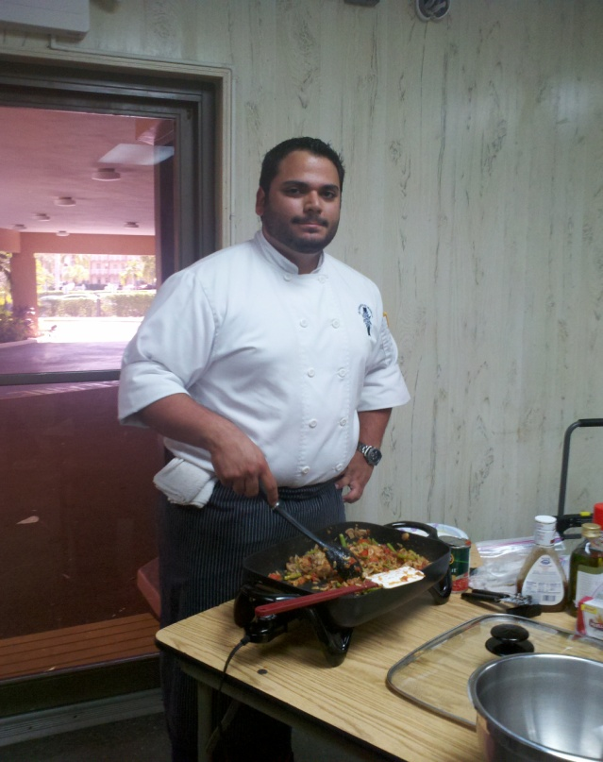
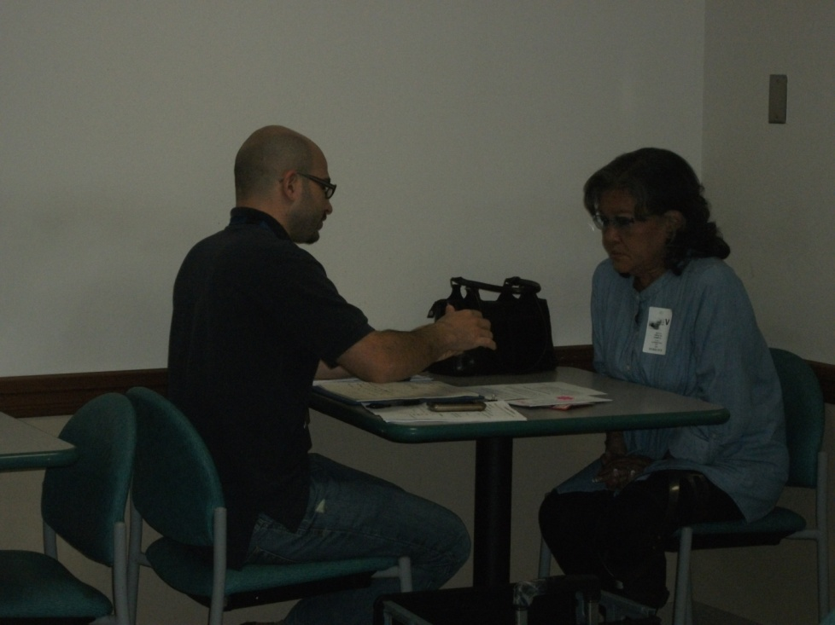
Class 1

Slide 16
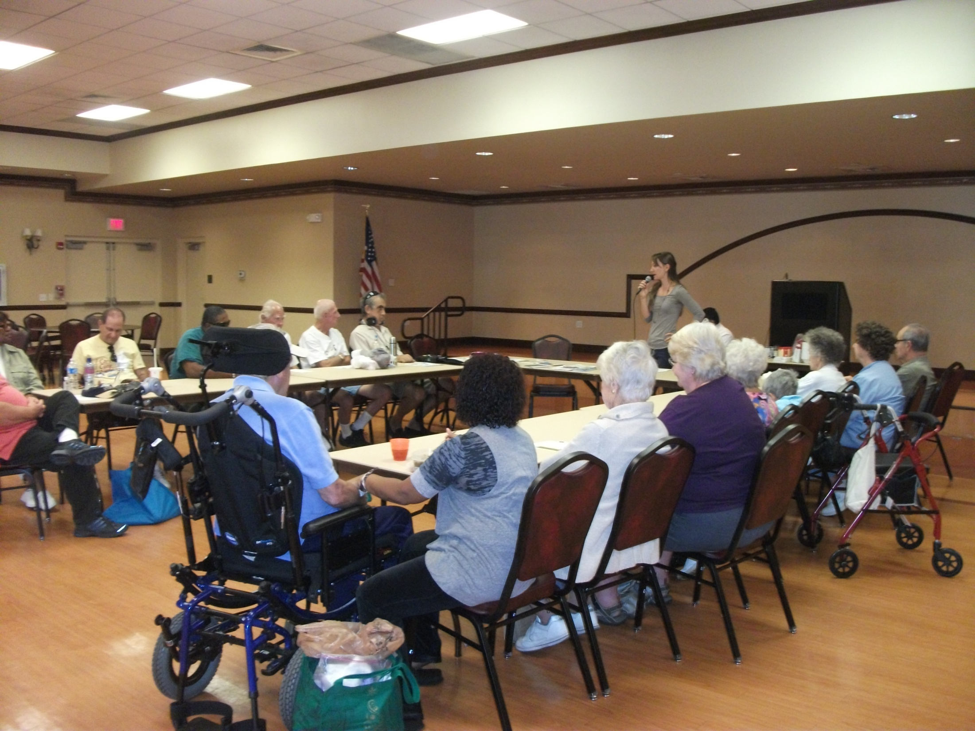
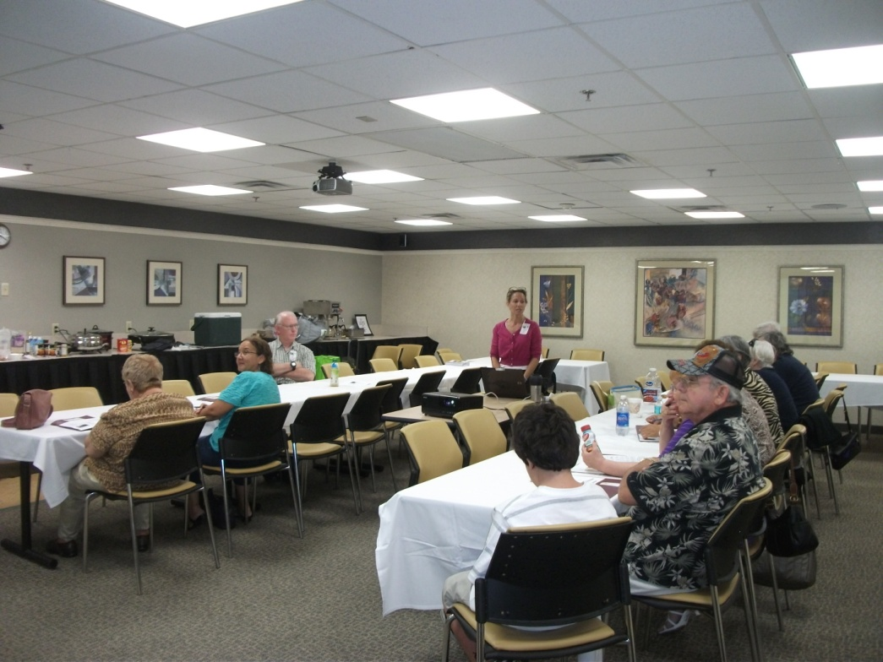
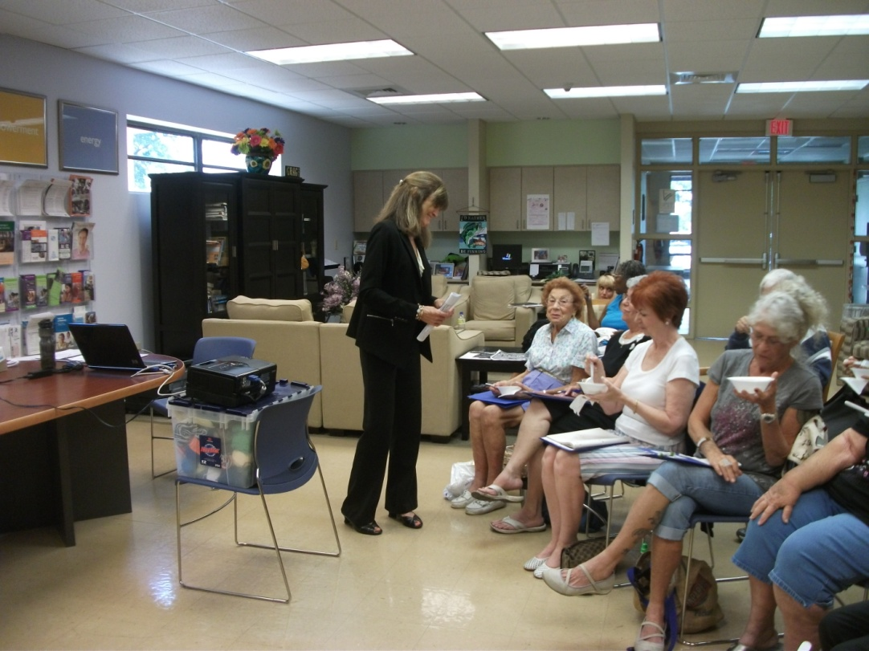
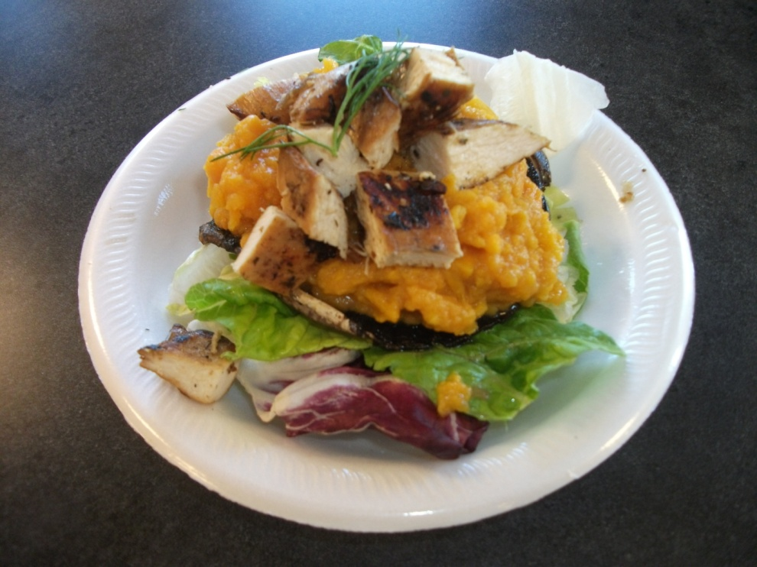
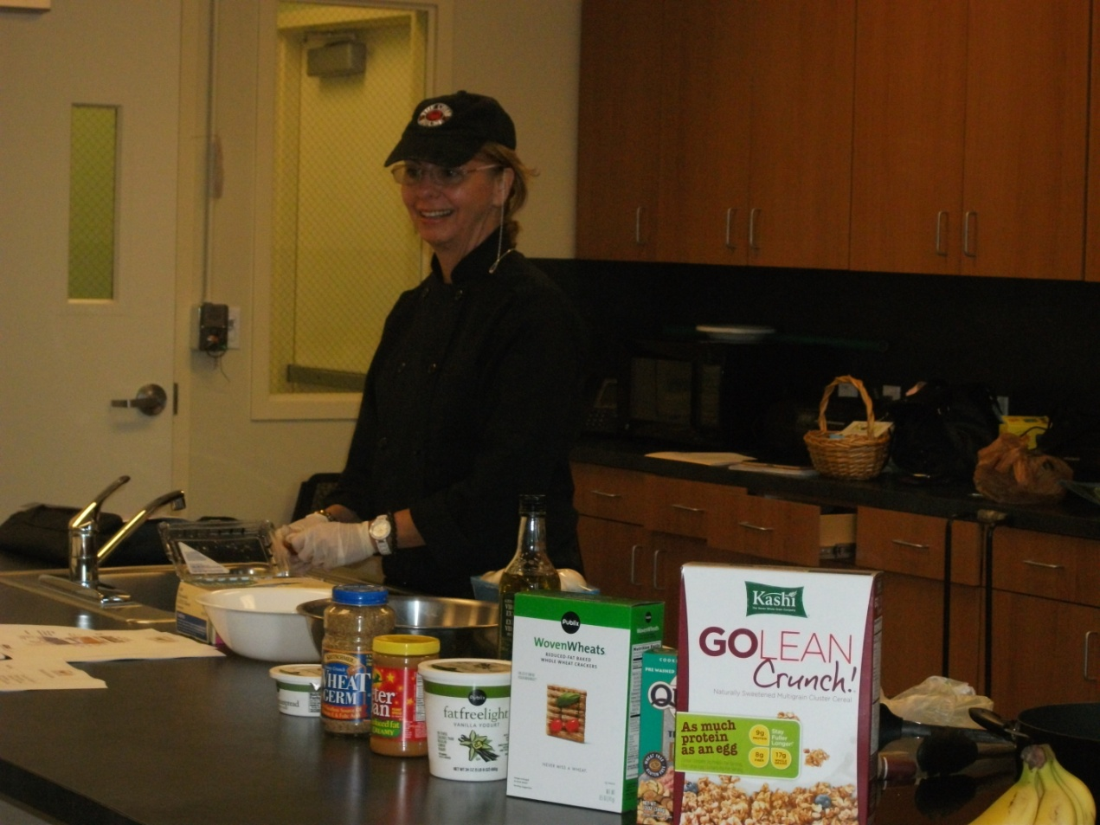
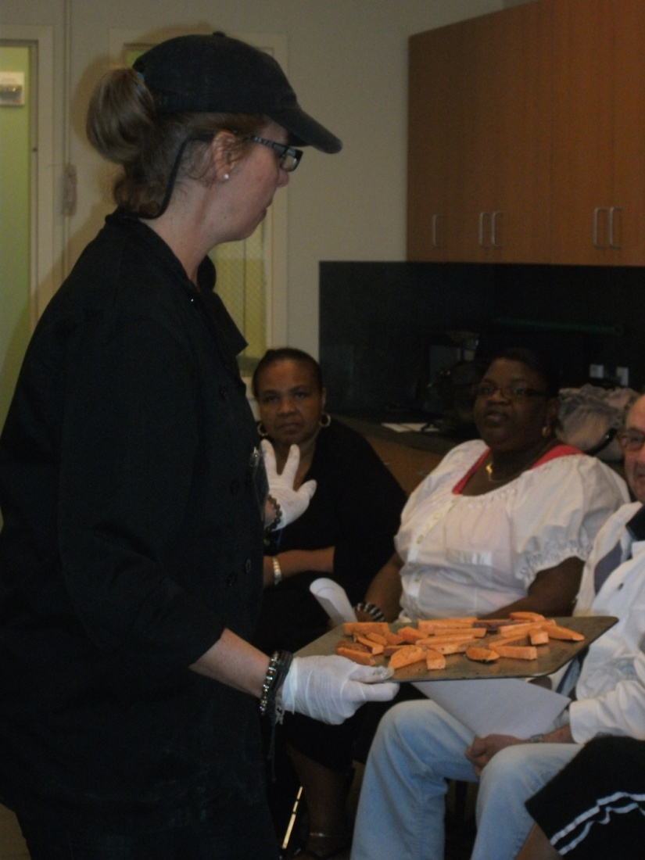
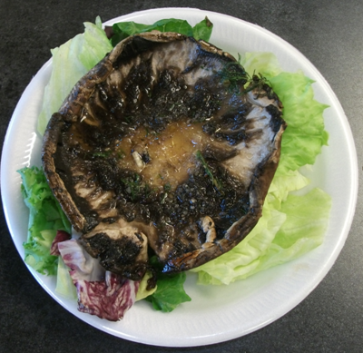
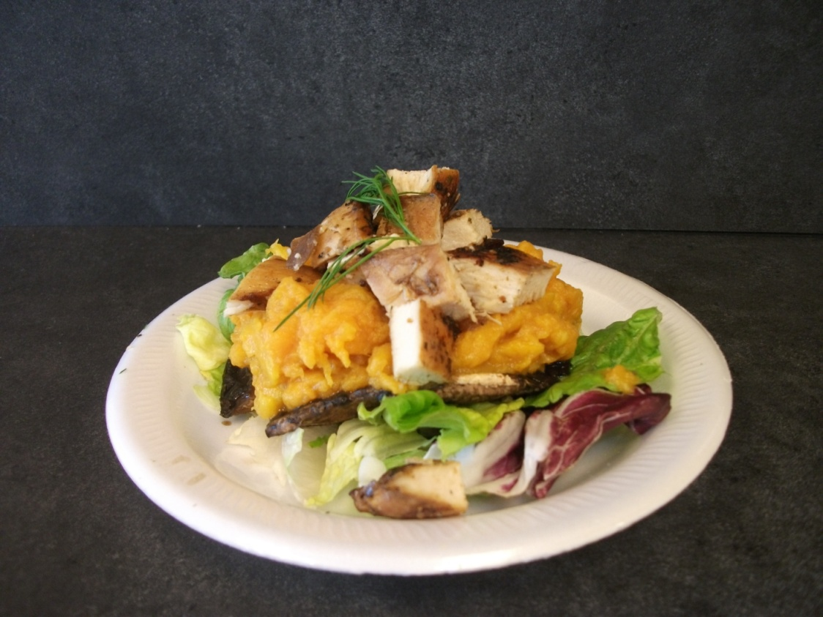
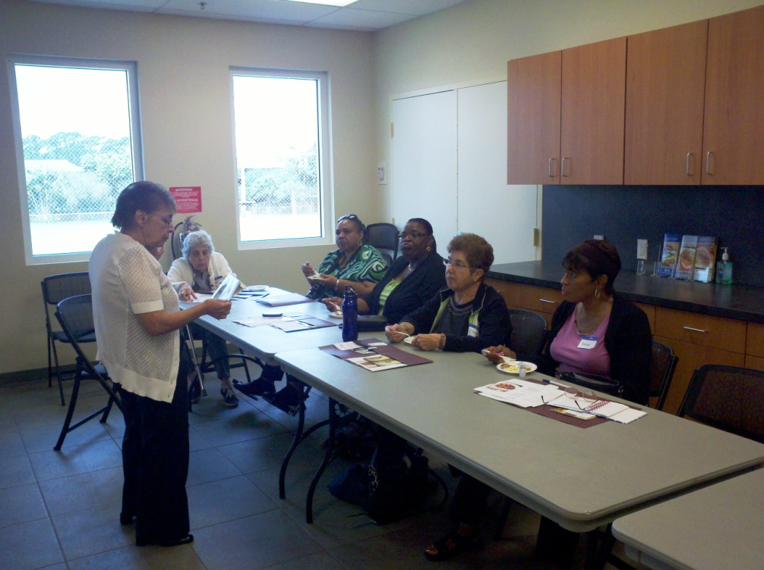
Class 2

Slide 17
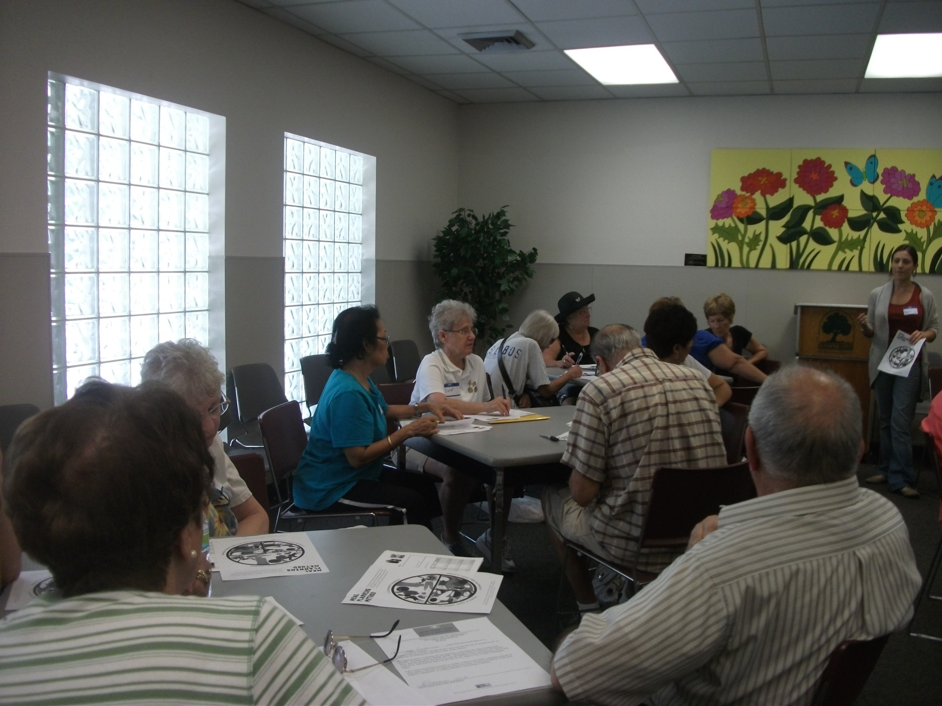
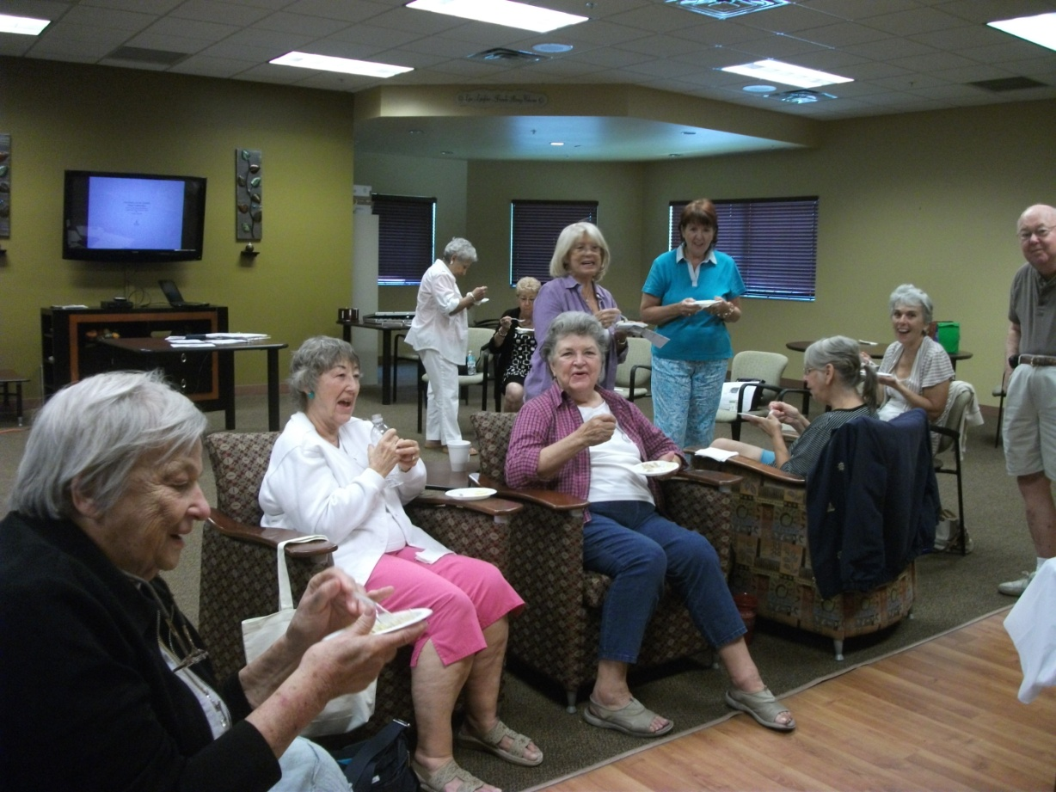
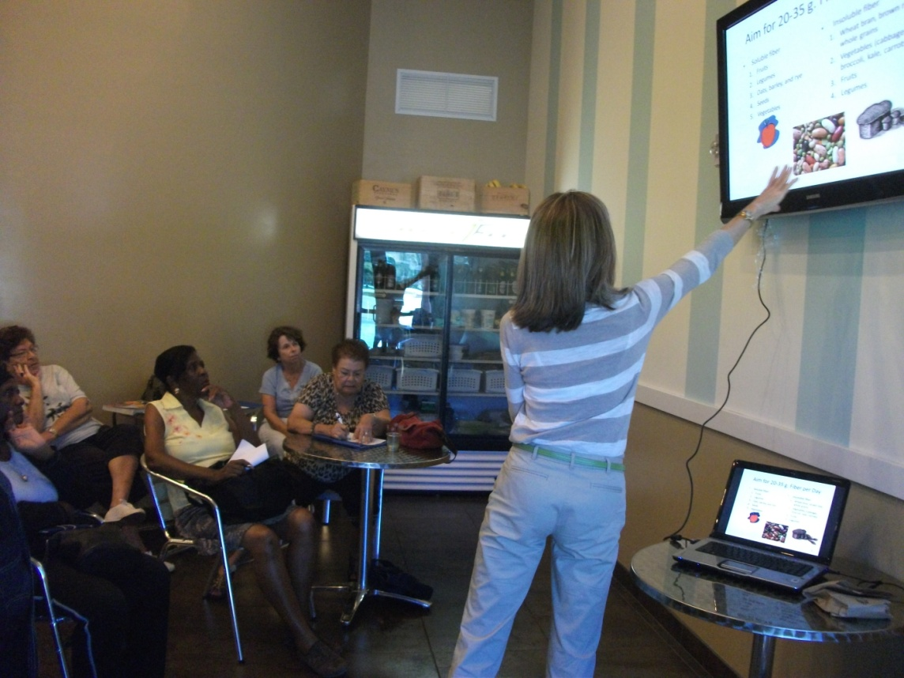
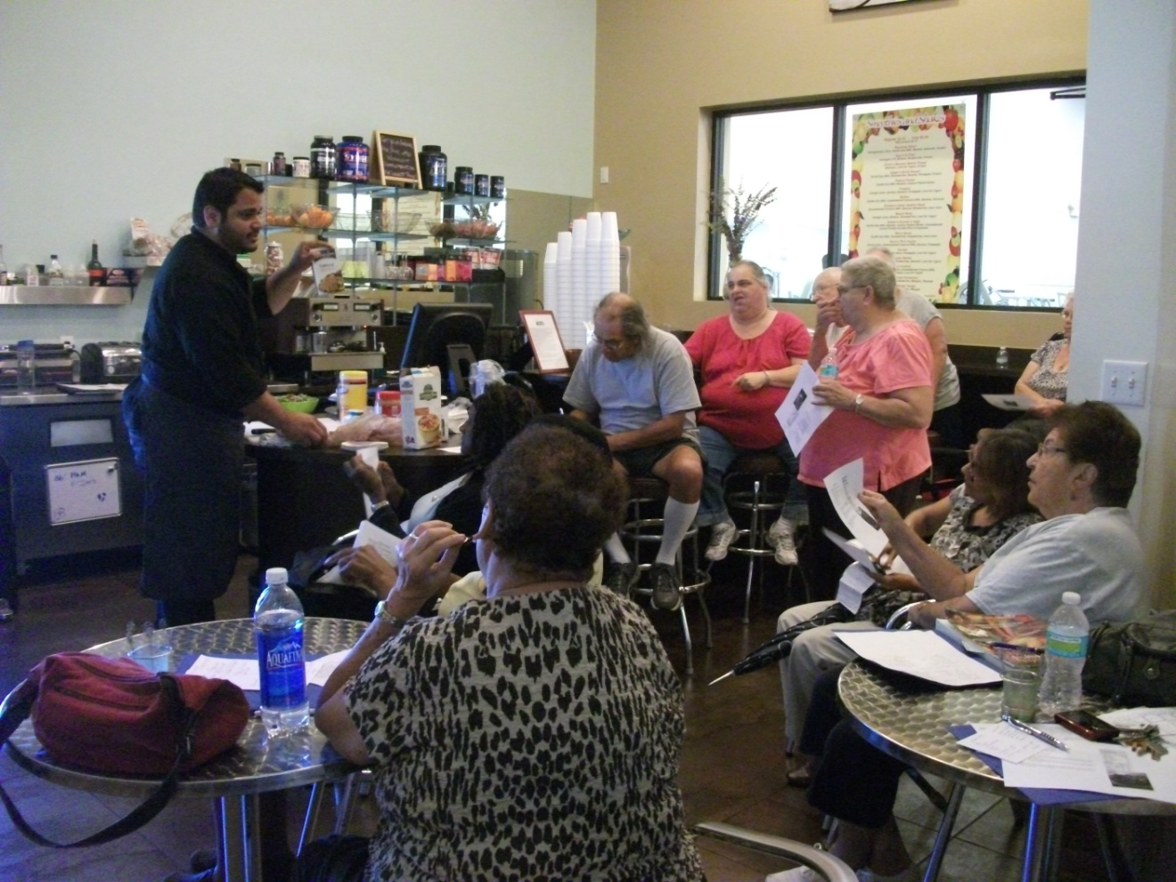
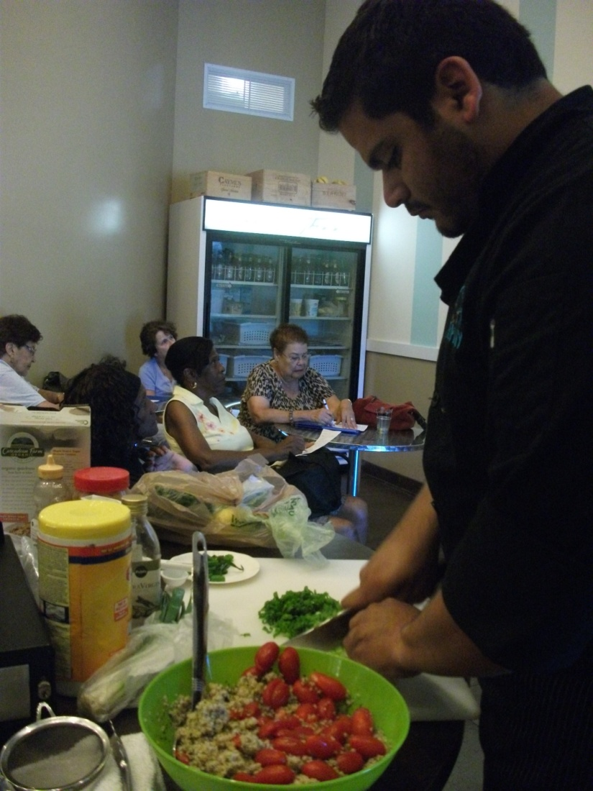
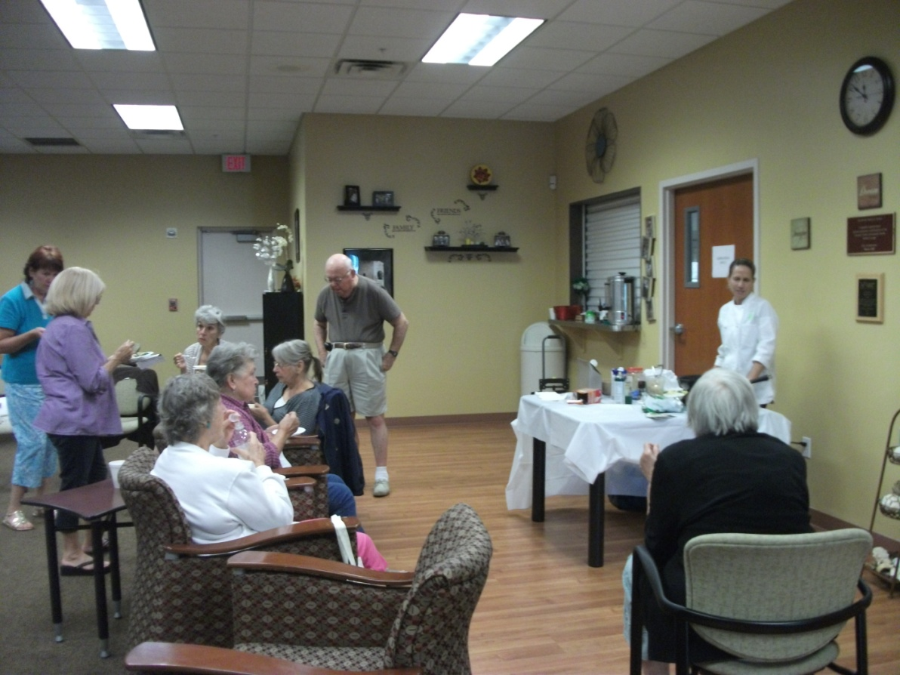
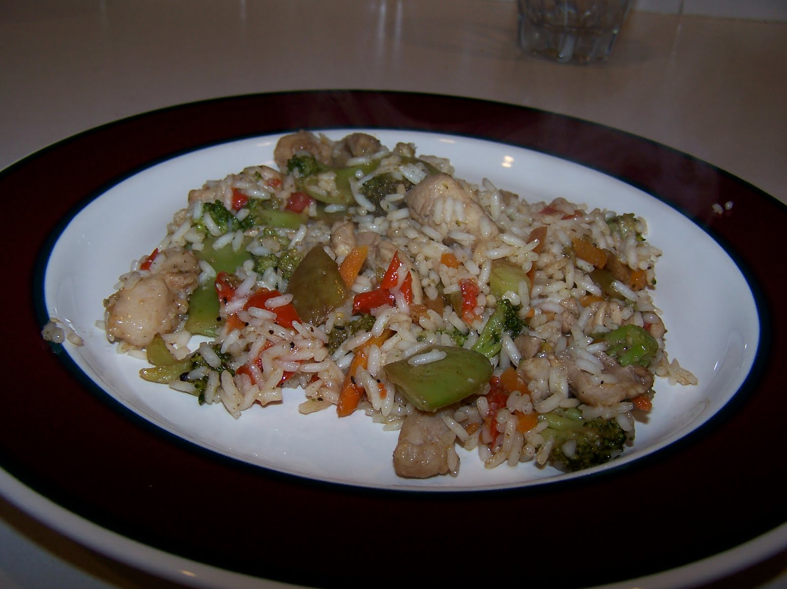
Class 3

Slide 18
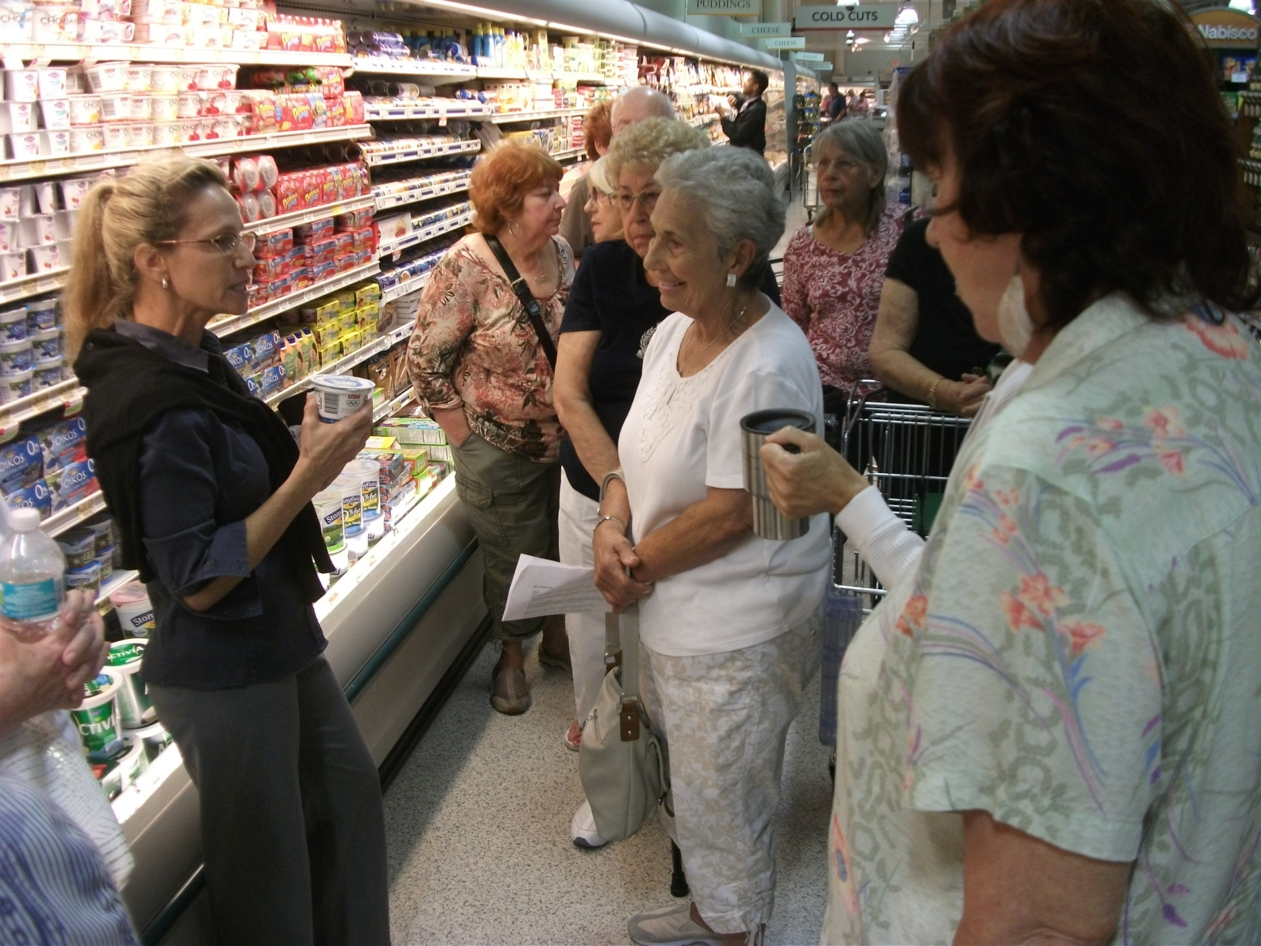
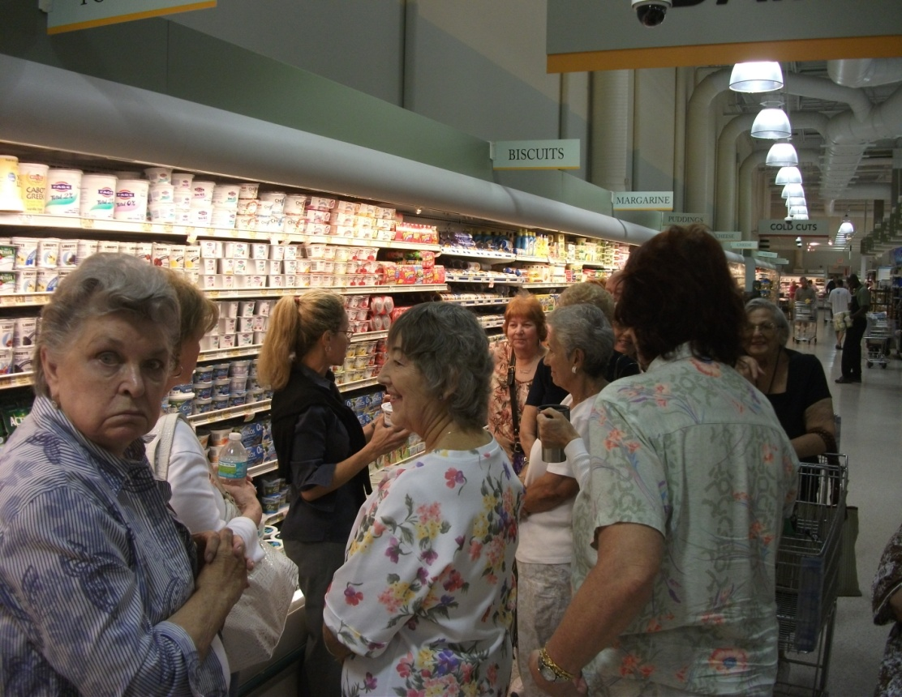
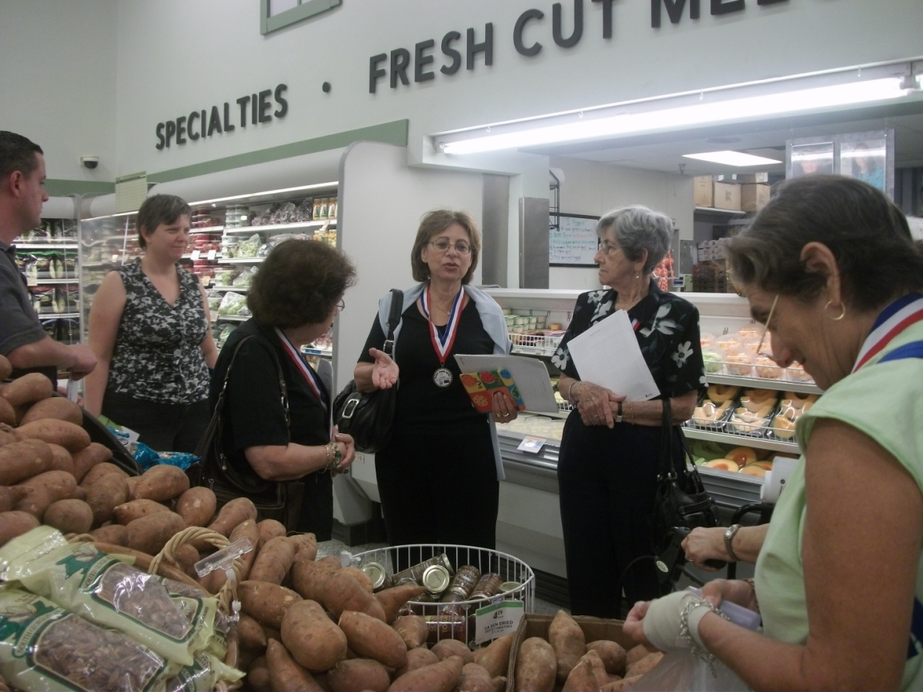
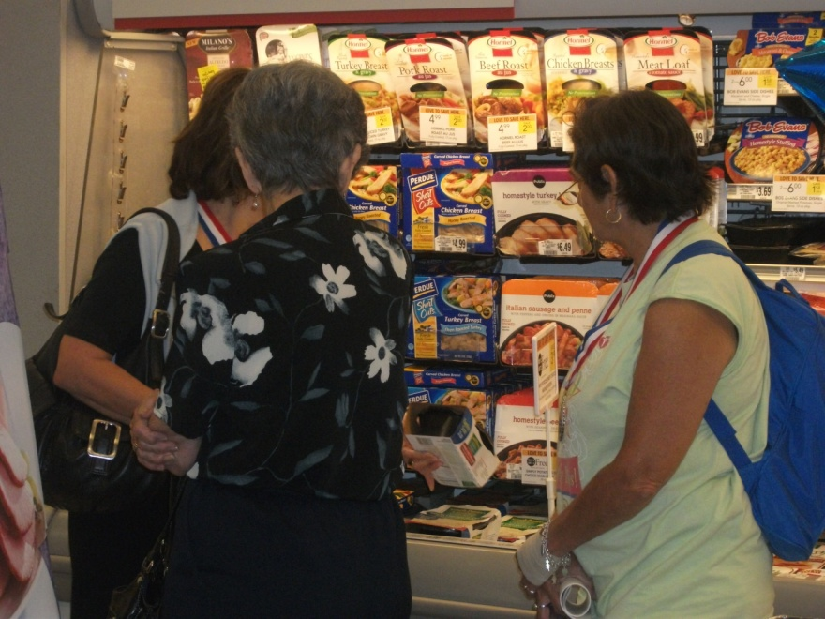
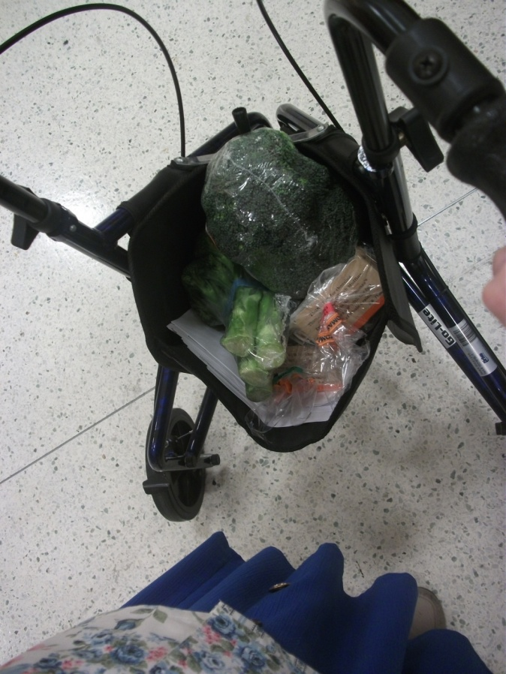
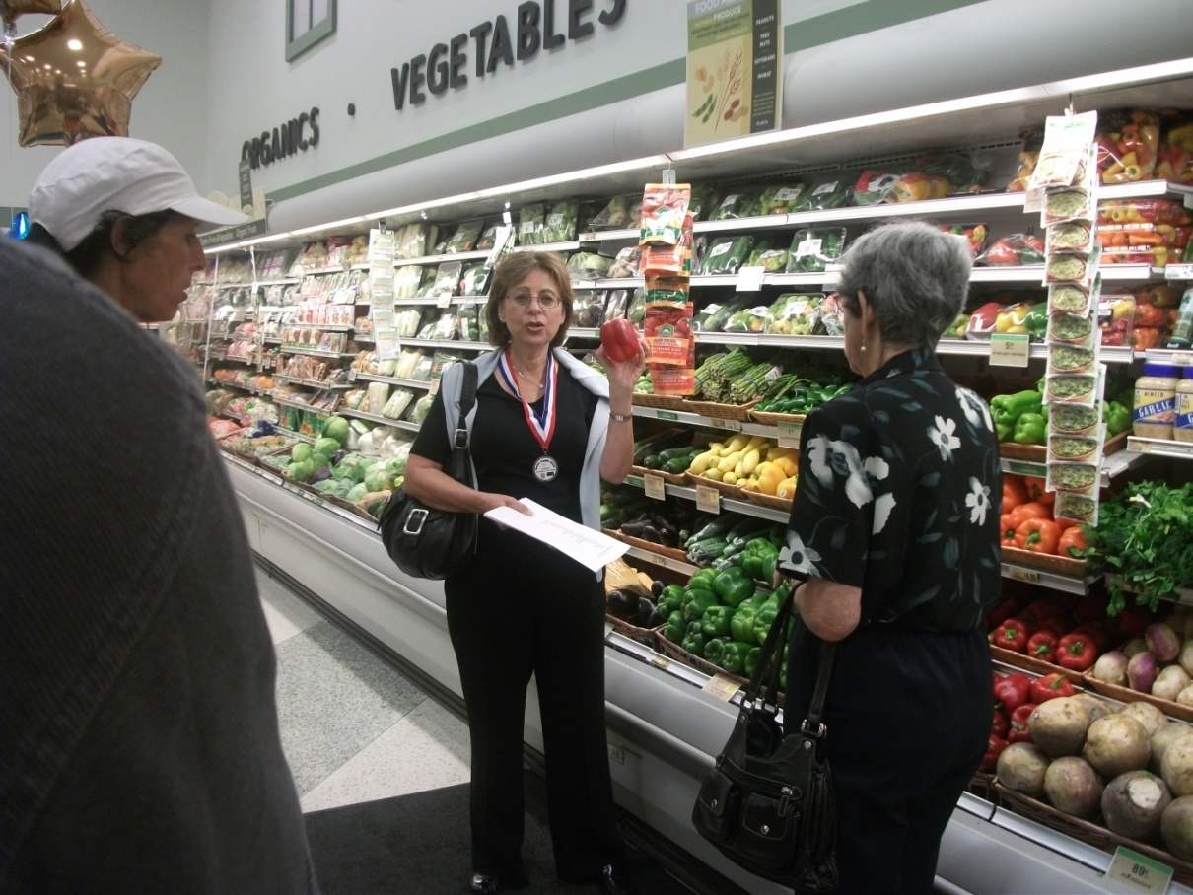
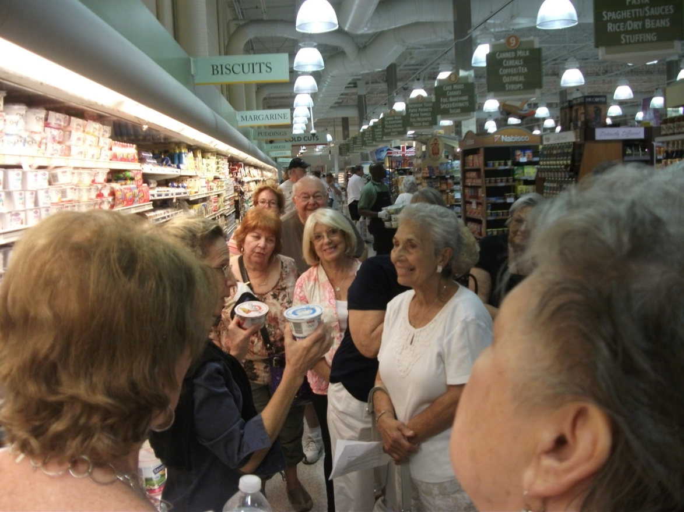
Class 4

Slide 19
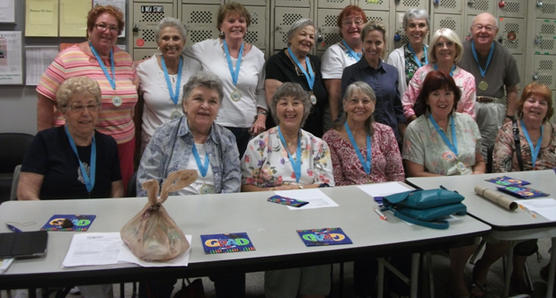
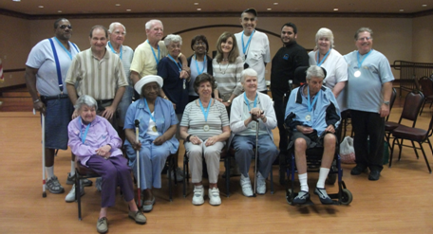
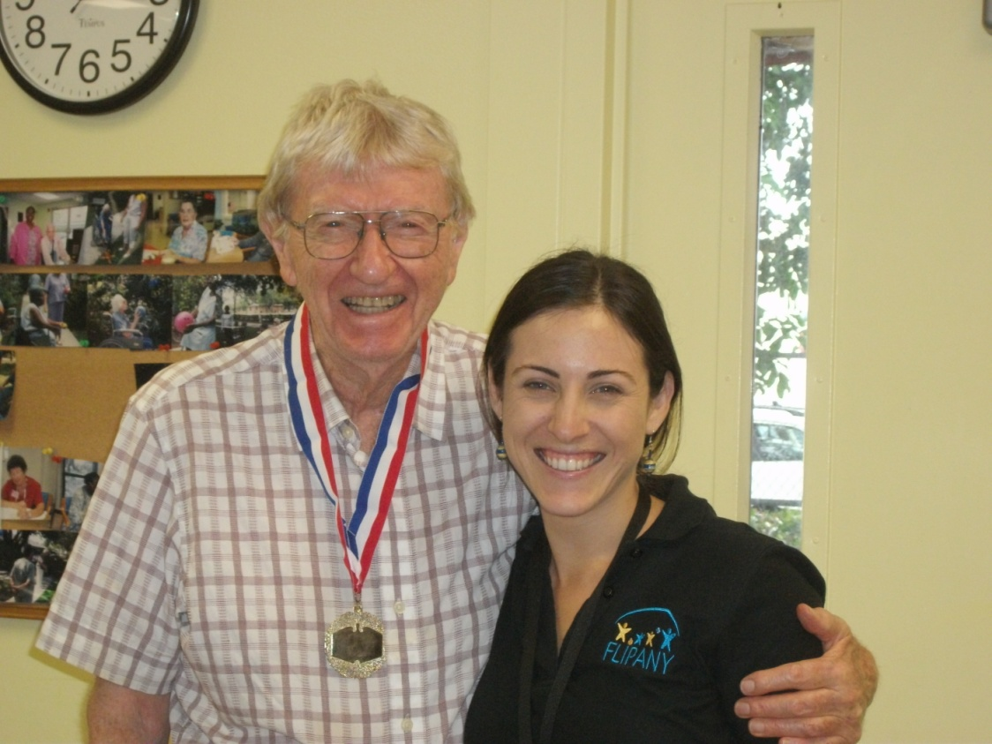
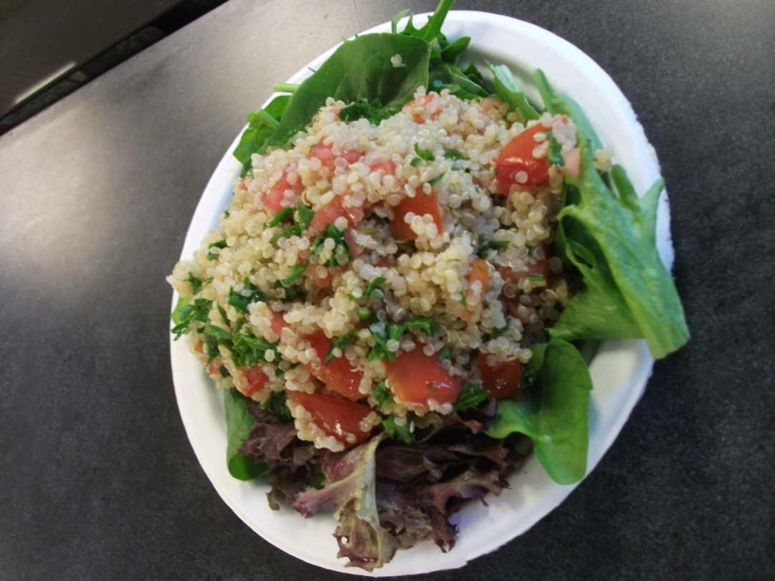
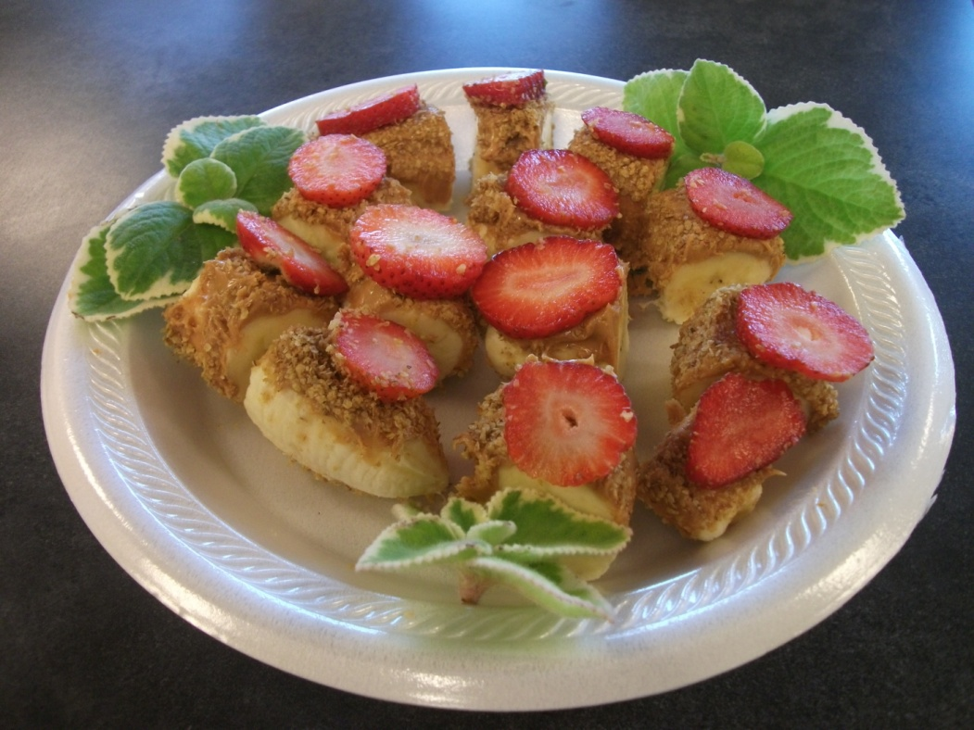
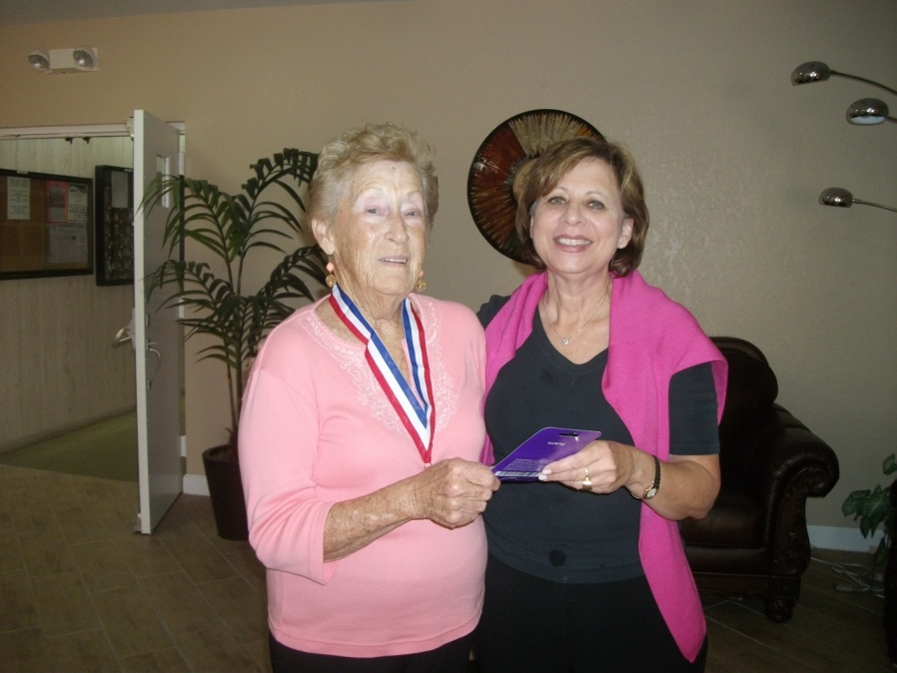
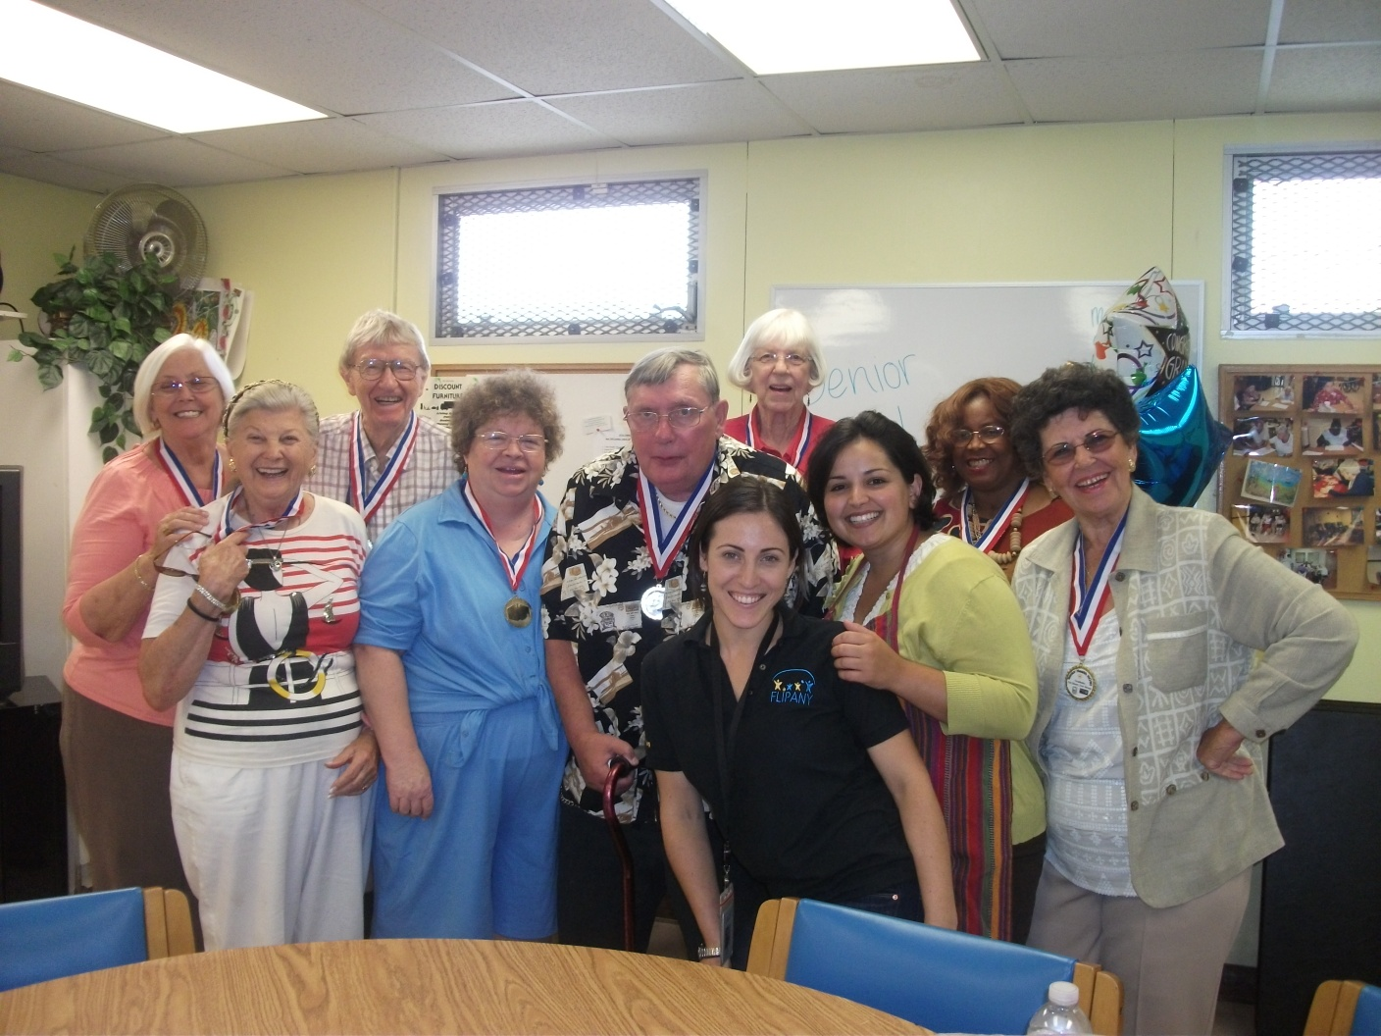
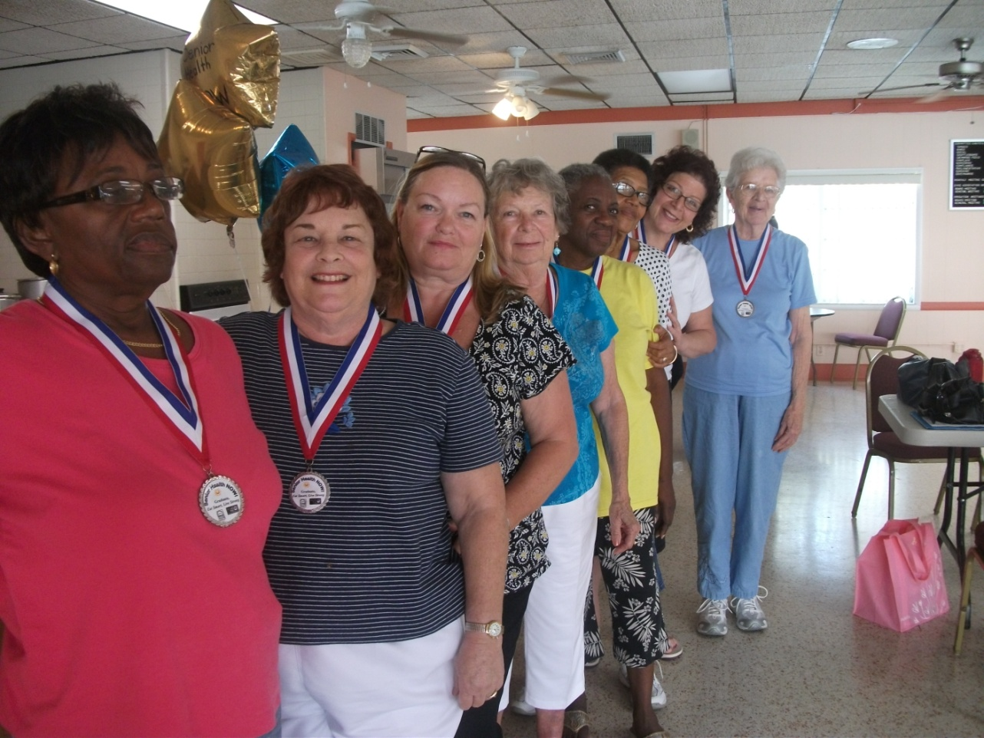
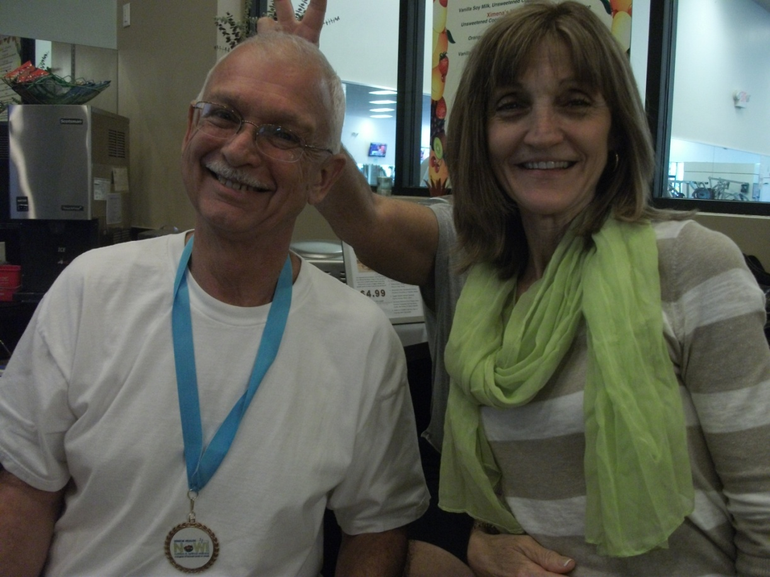
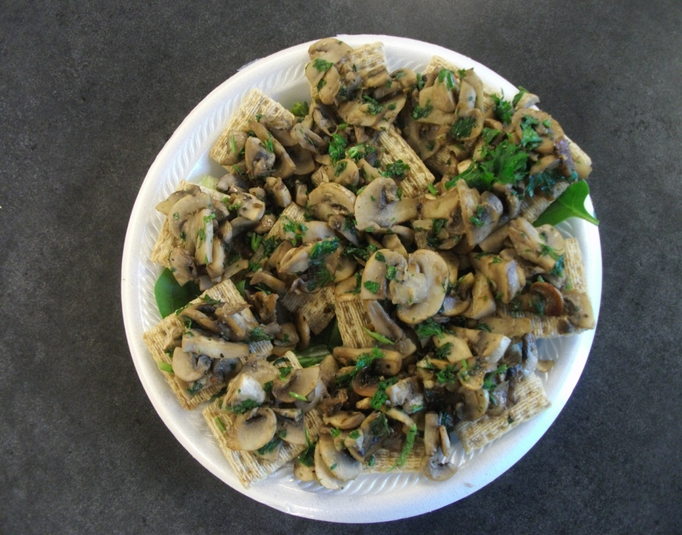
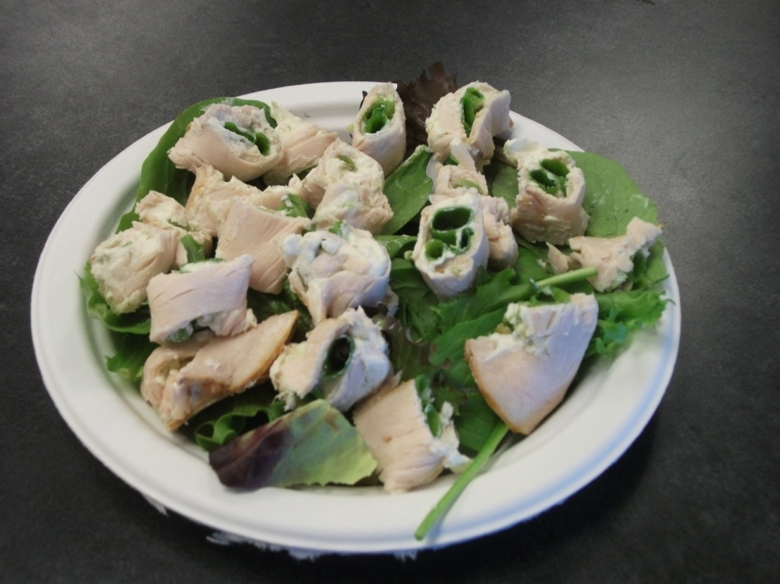
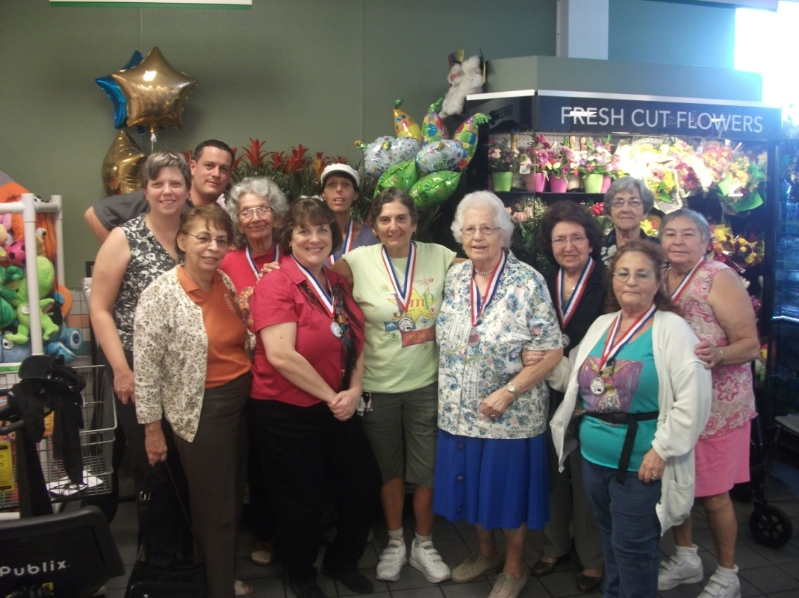
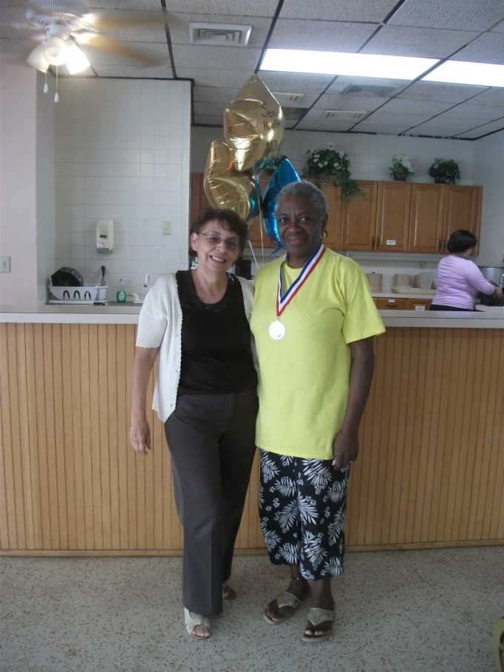
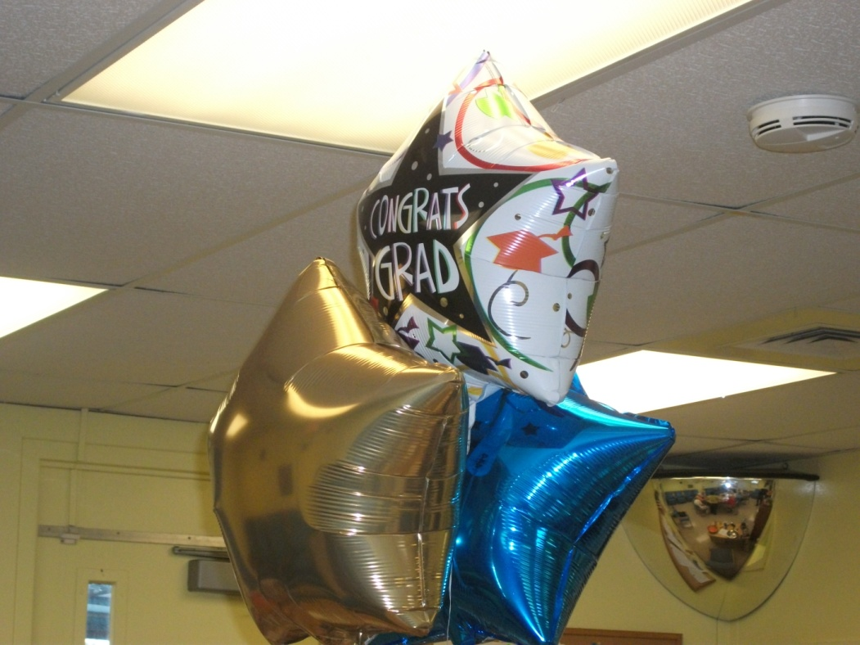
Class 5—Graduation

Slide 20
Thank you to our Partners and Participants for making this possible.

